Slide 1



ABAP on Hana s/4 Hana Training
Day 19
contact@anubhavtrainings.com

Slide 2

Agenda – Day 19
Create your OVP ( Overview page ) UX Elements show Analytical dashboard
S/4HANA End to End PoC of list report
Creating List Report Application
Describing Lifecycle of App
Understanding Deployment of App’s

Slide 3
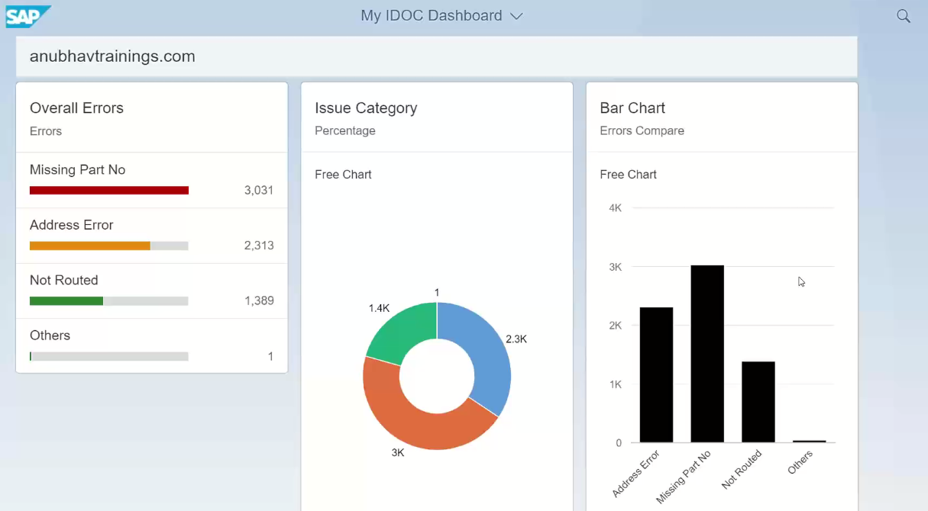
Analytic Dashboard ( OVP )
Analytic Dashboard (OVP) on top of CDS with the help of UI.Annotations ,it Calculate Overall Errors in following Categories of Analytics are Mentioned Below

Slide 4
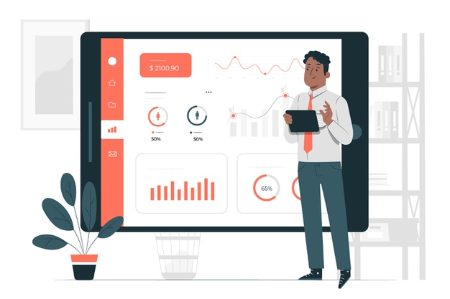
Exercise
End to End S/4 HANA Scenario for Overview Page ( OVP )

Slide 5

List Report
SAP Fiori elements contain predefined templates for list reports and object pages. A list report lets users filter, view, and work with items (objects) organized in list (table) format.
The list report is typically used in conjunction with an object page. Fiori Element List reports is one of the standard sap Fiori floorplans which offers features like users can view a large set of items. User can search the relevant items using filters, sorting, and grouping as out of box feature of this floorplan. such reports support without or minimal code and configurations on the client-side. All you require an annotation-based OData service either via CDS view exposed with annotations or with vocabulary integrated into gateway layer while OData development.

Slide 6
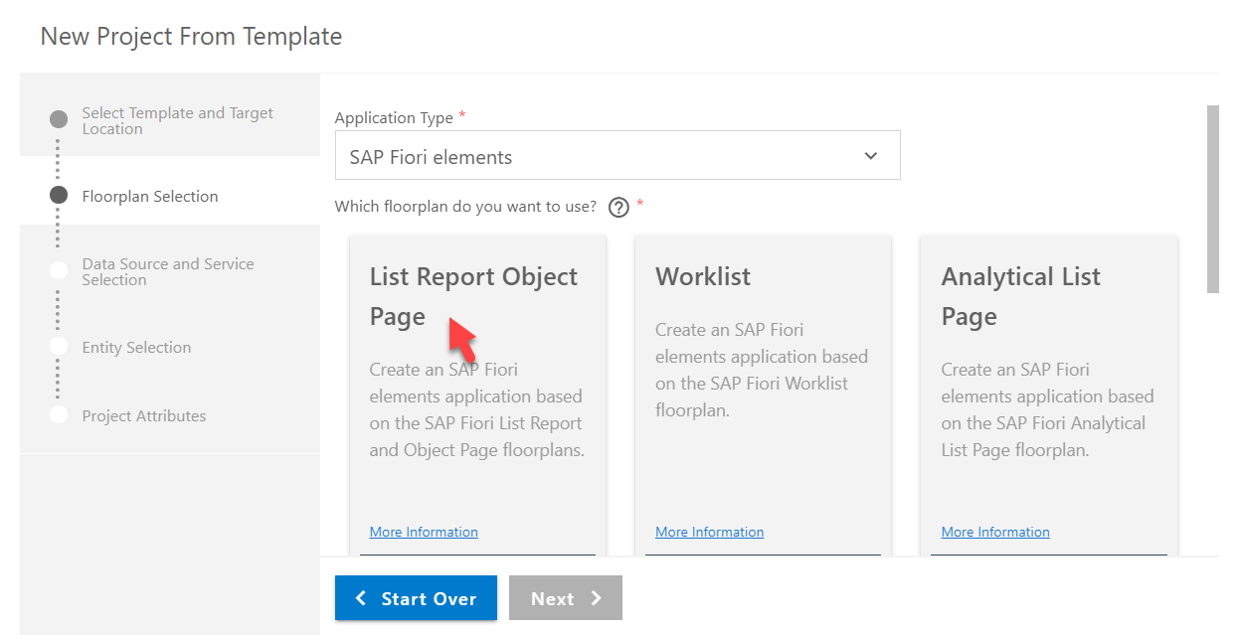

Creating List Report Application
Go to the template customization section and select the entity type from the dropdown on which you want to create a list report app and click on the Finish button. Now application project file is created in your workspace with all required files to run this app.
Exercise
List Report Application Code

Slide 7
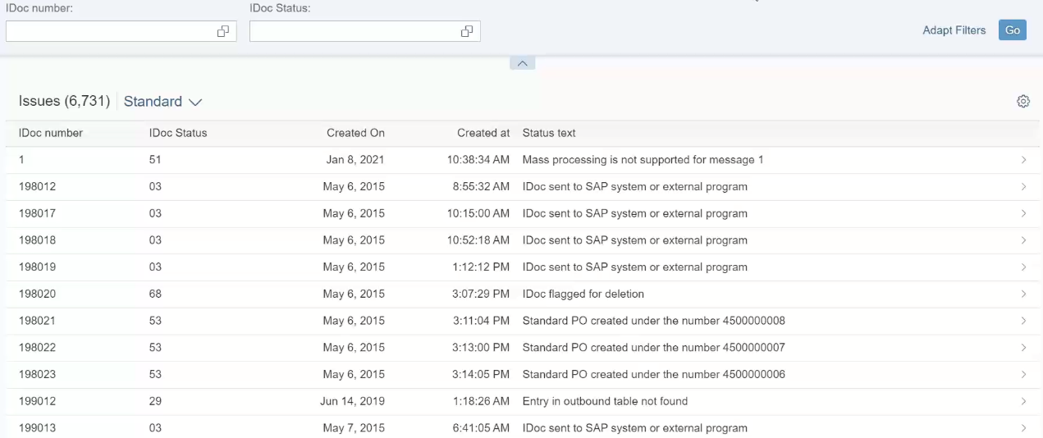
List Report Application Output

Slide 8

End of Day 19
Trainer: Anubhav Oberoy

Slide 9

Trainer: Anubhav Oberoy

Slide 10
THANK YOU
If you cannot do
great things, do small things in a great way.
Anubhav Oberoy
https://www.anubhavtrainings.com

Slide 11


We’re committed to empower you to be
Most Desirable Resource
through powerful training solutions.
We build the workforce of the future.
250+
Corporate Clients
30,000+
Learners Trained
25000+
Learners Placed
FREE WEBINARS
Sign up for free webinars with industry experts every fortnight!
Enroll Now!
Contact us today!
https://anubhavtrainings.com/

Slide 12




More from AnubhavTrainings.com

